Slide 1
6th Amendment
The 6th Amendment guarantees a speedy trial (you can’t be kept in jail for over a year without a trial)
an impartial jury (doesn’t already think you are guilty)
that the accused can confront witnesses against them
the accused must be allowed to have a lawyer

Slide 2
7th Amendment
The 7th Amendment guarantees the right to a speedy civil trial.
A civil trial differs from a criminal trial. A civil trial is when someone sues someone else. A criminal trial is when the state tries to convict someone of a crime.

Slide 3
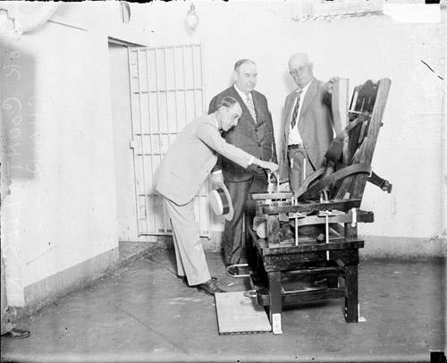
8th Amendment
The 8th Amendment guarantees that punishments will be fair and not cruel, and that extraordinarily large fines will not be set.

Slide 4
9th Amendment
All rights not stated in the Constitution and not forbidden by the Constitution belong to the people.
This means that the states can do what they want if the Constitution does not forbid it.

Slide 5
10th Amendment
The 10th Amendment states that any power not granted to the federal government belongs to the states or to the people.

