Slide 1
The Legislative Branch of Government

Slide 2
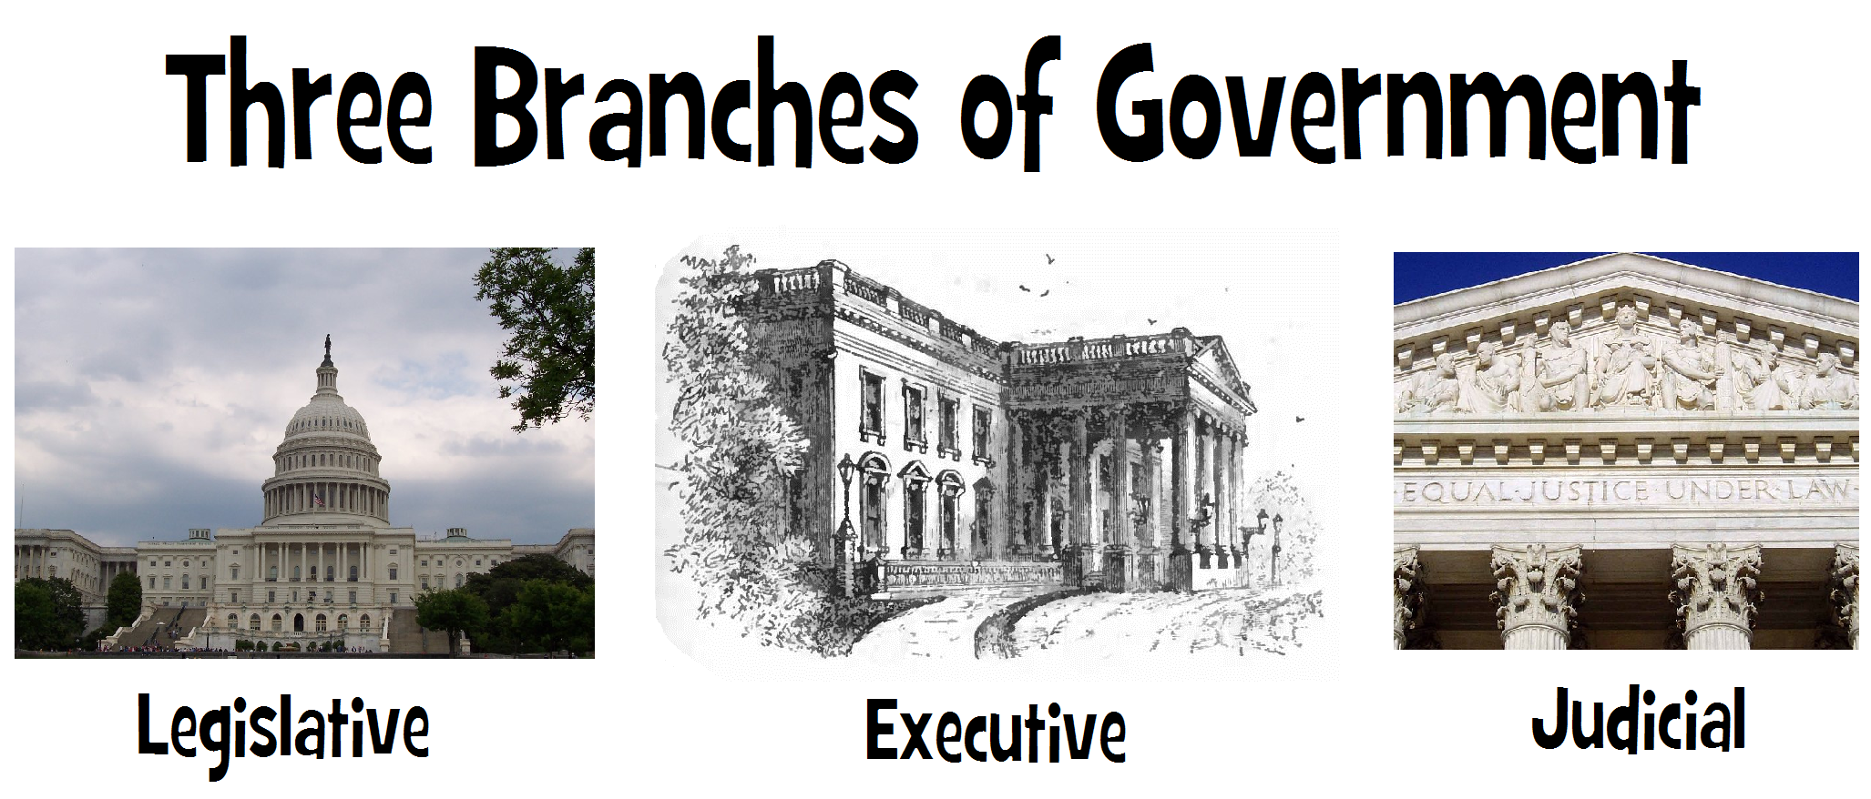

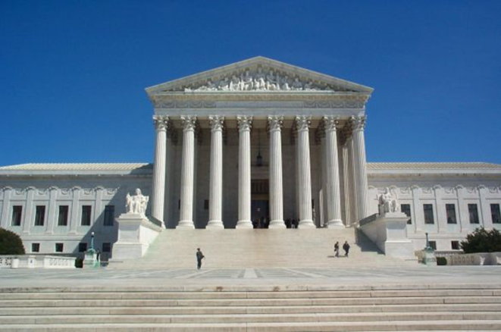
Because of the idea of Separation of Powers

Slide 3


Slide 4

The Capital – The Legislative Branch
The people’s branch
of government

Slide 5




The Capital – The Legislative Branch

Slide 6

The Legislative Branch
The branch of government that makes the laws

Slide 7
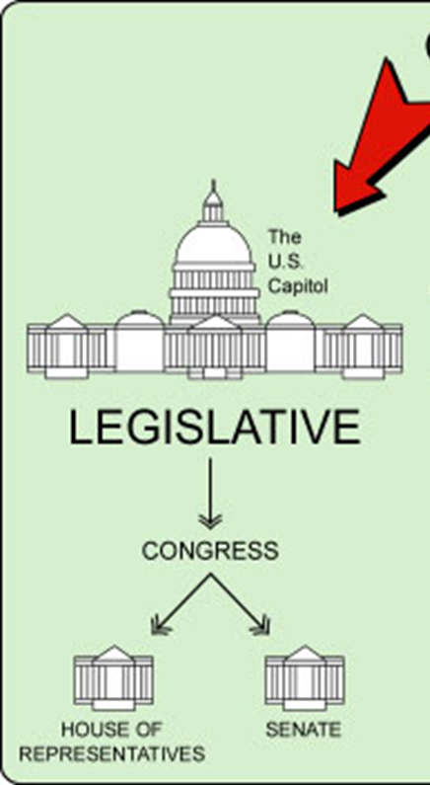
The Legislative Branch
The Great Compromise says that
legislative branch has 2 parts
  The Senate
  The House of Representatives

Slide 8
The Legislative Branch
The Senate
The House of Representatives
Members called:
  Senators
Elected every 6 years
Only 2 from every state
Total number of senators: 100
Must be at least: 30 years old
Salary: $174,000
Members called:
  Representatives
  Congressmen/
  Congresswoman
Elected every 2 years
How many each state has depends on the population of the state: 435 now
Must be at least: 25 years old
Salary: $174,000

Slide 9
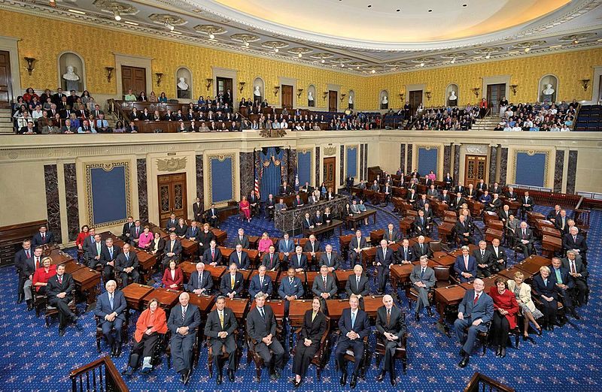
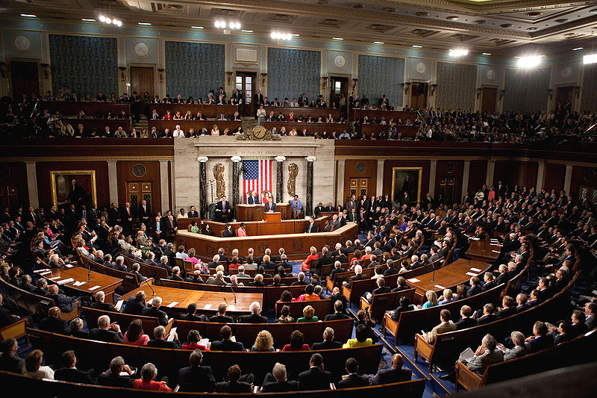
The Legislative Branch
The House of Representatives
“The lower house”
The Senate
“The upper house”

Slide 10

The House of Representatives
435 members
1 member = 1 vote
Each state has a different number of representatives
More people = more representatives

Slide 11
The House of Representatives
Leader: Speaker of the House
Elected by The House of Representatives

Slide 12
The House of Representatives
The Speaker of the House duties/power:
  Runs the sessions of the House
  Keeps order
  Must recognize people to speak
  Applies all the rules of the House
  Sends bills to committees
  Can appoint members to committees

Slide 13

The Senate
100 members
1 member = 1 vote
Each state has 2 senators

Slide 14
The Senate
Leader: President
President of the Senate = Vice President of the US
Sub President of the Senate = Pro tempore (for the time being)
Pro tempore elected by the senators

Slide 15
The Senate
The President of the Senate:
  Not a senator
  Cannot speak for or against a bill
  Can vote only to break a tie
  Does not have to vote

Slide 16


Powers of Congress
Business
  Can make rules for trade and business

Slide 17



Powers of Congress
War
  Can protect the nation against enemies
  Can declare war
  Can make armies & navies

Slide 18
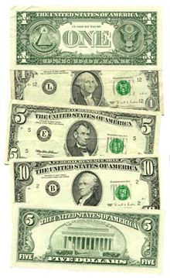

Powers of Congress
Money
  Can raise and collect taxes
  Can print money
  Can decide how much money is worth
  Can borrow money for the USA
  Can make laws about bankruptcy

Slide 19
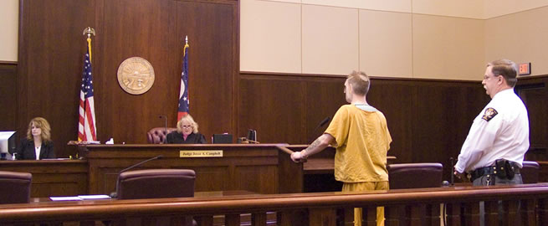
Powers of Congress
Courts
  Can establish all federal courts
  Can set rules for courts

Slide 20

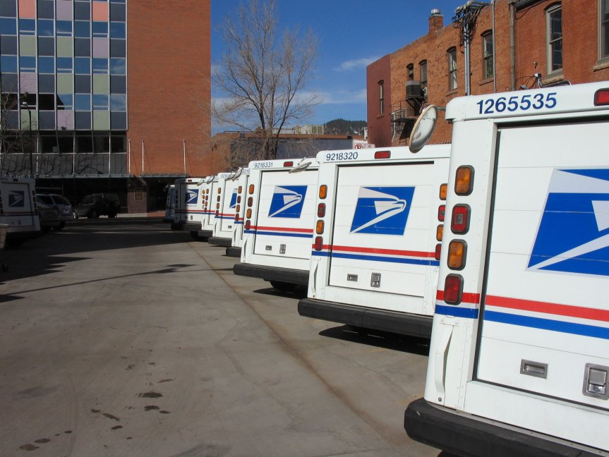


Powers of Congress
Government agencies:
  Can establish (make) rules for the post office
  Runs national highway system
  Runs national parks
  Runs all federal buildings

Slide 21
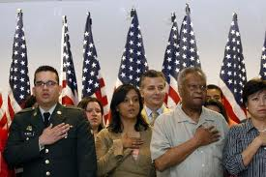

Powers of Congress
Citizens:
  Can make rules about how to become a citizen
  Can give copyrights

Slide 22
The Legislative Branch
The Senate
The House of Representatives
Power to approve treaties
Impeachment trial for the president, decide if the president is guilty or not
Start bills for the budget and taxes
Impeach the president
Pick the president if there is a tie

Slide 23
Congress CAN’T
Create a national school system
Set rules for marriage and divorce
Set a minimum age for driver’s licenses
Set rules for units of local governments
Order people to be held in prison without their rights
Take money from the federal government without passing a law
Tax any goods exported from states
Grant titles of nobility (king, queen, etc…)

