Slide 1
Persuasive Writing

Slide 2
Persuasive Writing Vocab
Persuasion
Persuasive text
Supporting evidence:
Authors Position
Main Idea
Fact
Opinion
Purpose

Slide 3
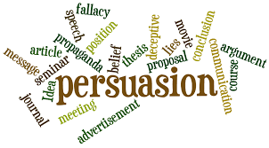
Persuasion
to influence a point of view by means of argument or reasoning.
the act of persuading someone to do or believe something

Slide 4
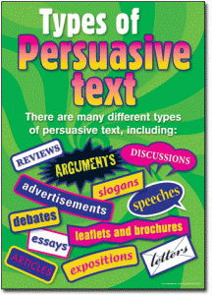
Persuasive Text
any writing in which an author is expressing facts or opinions to try to convince the reader.

Slide 5
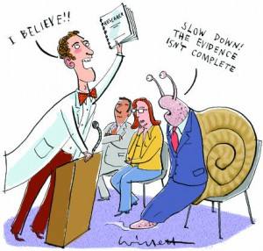
Supporting evidence
facts, details, statistics, or examples that help to form judgements
Crucial part in body paragraphs

Slide 6
Authors position
A standpoint or attitude that the author holds toward an idea
The writers opinion on the topic

Slide 7
Main Idea
the central topic of a piece of writing.

Slide 8
Fact
Something that is true and can be proven with evidence

Slide 9
Opinion
A personal belief
A view or judgement formed about something not based on facts

