Slide 1
Good Afternoon 8th Graders!
Please get your red folders, notebooks, and sit quietly at your seat.
Today’s lesson is about the Preamble.
We will read the Preamble together and go over it’s six goals
As we are reading, circle any words that you do not know the meaning!

Slide 2
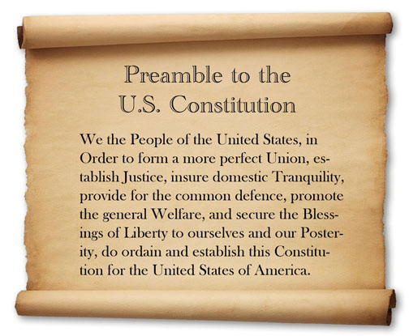

Slide 3
Form a More Perfect Union
What do you think?
In order to improve the country

Slide 4
Establish Justice
What do you think?
Create Fairness

Slide 5
Insure Domestic Tranquility
What do you think?
Create peace in the country

Slide 6
Provide for the Common Defense
What do you guys think?
Provide for protection and defense of the country

Slide 7
Promote the General Welfare
What do you guys think?
Take care of the U.S. citizens

Slide 8
Secure the Blessings of Liberty for Ourselves and our Posterity
What do you guys think?
Make sure everyone gets their basic living rights
Notes:
Posterity-children

Slide 9
In other words…
We the people of the United States, in order to improve our country, create fairness, create peace in our country, provide for protection and defense of the country, take care of U.S. citizens, and make sure everyone gets their basic living rights, do ordain and establish this Constitution for the United States of America.
Thoughts?
Notes:
Ordain-appoint, install, make

